Slide 1

Unit 6:Distributed Memory Architecture.
Point 3–Interconnection Networks-Crossbar switch and Multiport Memories
Dr. Mrs Mamata Sachin Kalas
Email id:kalas.mamta@kitcoek.in

Slide 2
Crossbar Switch
If the number of buses in a time shared bus is increased, a point is reached at which there is a separate path available for each memory unit. The interconnection networking is called as a nonblocking crossbar.
Separate bus is associated with each memory module.
Interfaces between switch and functional units are simple.
Conflict occurs in system using crossbar switch when two or more concurrent requests are made to the same destination.
Interconnection Networks-Crossbar switch and Multiport Memories

Slide 3
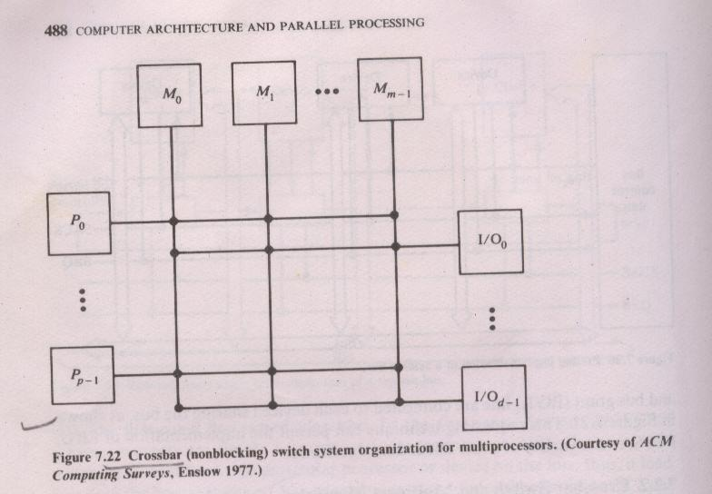
Crossbar Switch
Interconnection Networks-Crossbar switch and Multiport Memories

Slide 4
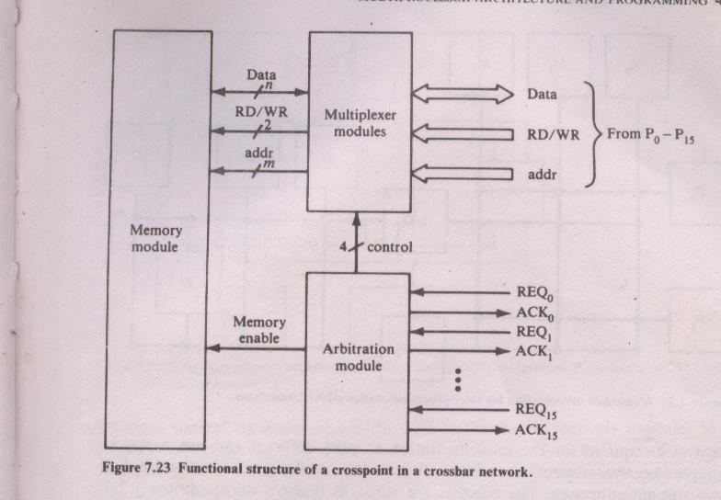
Structure of crosspoint
Arbitration module: selects the processor with the highest priority.
Multiplexer module: multiplexes data, addresses of words and control signal from processor to memory module.
Interconnection Networks-Crossbar switch and Multiport Memories

Slide 5
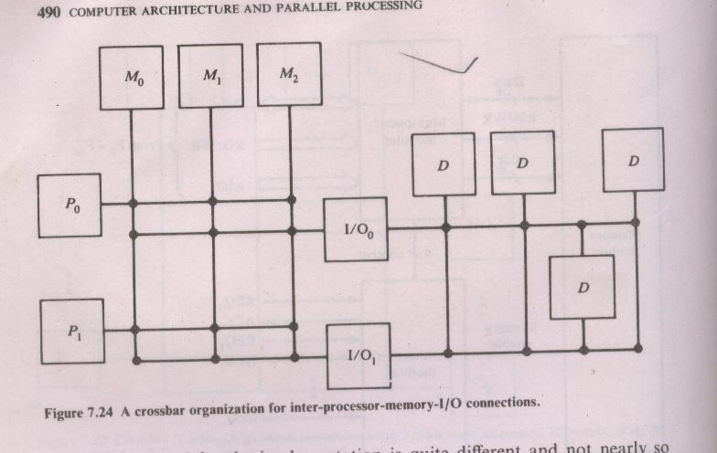
Extension of crossbar
Crossbar extension is to use the same switch on device side of i/o processor. This provides flexibility in accessing i/o devices.
Interconnection Networks-Crossbar switch and Multiport Memories

Slide 6
Advantages & Drawbacks of crossbar
Advantages:
It provides highest bandwidth and system efficiency.
Drawbacks:
1. Complexity and cost is very high.
2. Reliability is problematic
Interconnection Networks-Crossbar switch and Multiport Memories

Slide 7
Multiport memory
In multiport memories control, switching and priority arbitration logic is distributed at the interfaces to memory modules.
Permanently designated priorities are assigned at each memory port.
Reconfiguration is done at each installation.
Interconnection Networks-Crossbar switch and Multiport Memories

Slide 8
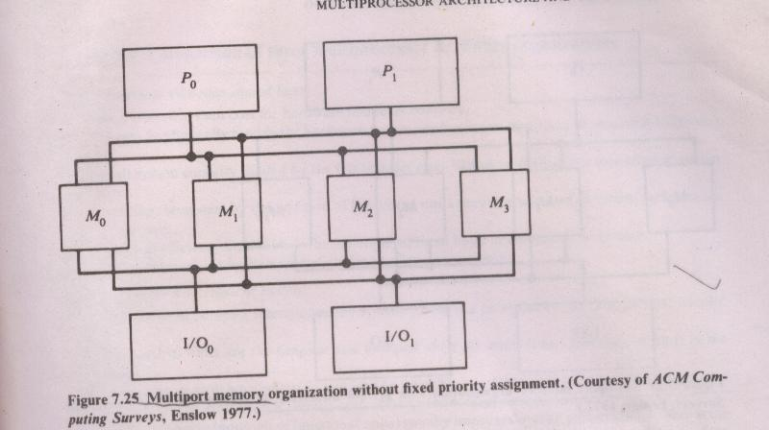
Multiport memory
Interconnection Networks-Crossbar switch and Multiport Memories

Slide 9
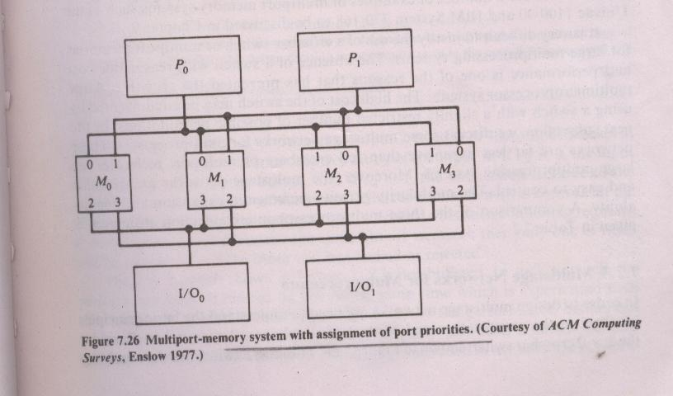
Multiport memory contd..
Reconfiguration make it possible to designate part of memory as private to some processor, i/o units or combinations.
Interconnection Networks-Crossbar switch and Multiport Memories

Slide 10
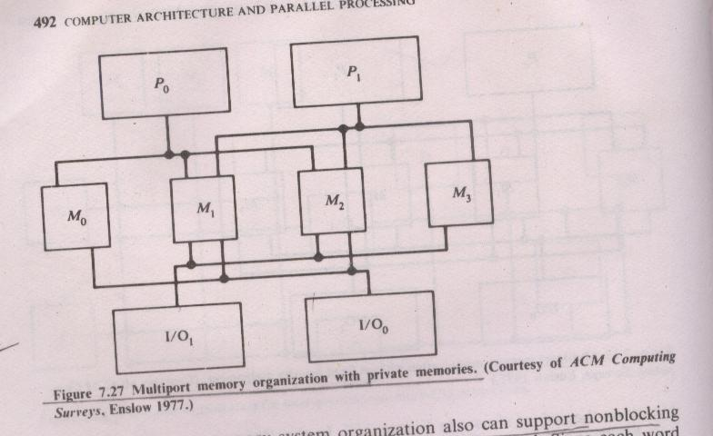
Multiport memory contd..
Interconnection Networks-Crossbar switch and Multiport Memories

Slide 11
Multiprocessor operating systems
Operating system requirements for :
  Resource allocation and management
  Memory and dataset protection
  System deadlock prevention
  Exception handling
Additional requirements for multiprocessor OS:
  Efficient resource utilization
  IO and processor load balancing
  System reconfiguration
Interconnection Networks-Crossbar switch and Multiport Memories

Slide 12
Multiprocessor operating systems
Master-Slave operating system.
Separate Supervisor in each processor.
Floating supervisor operating system.
Interconnection Networks-Crossbar switch and Multiport Memories

Slide 13
Multiprocessor operating systems
Master-Slave operating system:
  Supervisory routine runs on the same processor.
  Master processor maintains the status of all the processor.
  It distributes the work to slave processors.
  Slave processor requests via trap or supervisor call instruction .
  Supervisor need not be reentrant .
Advantages:
  Simple to implement.
disadvantages:
  Susceptible to failures.
  Inefficient in control and resource utilization.
Applications:
  Effective for well defined workload application and asymmtrical systems.
Interconnection Networks-Crossbar switch and Multiport Memories

Slide 14
Multiprocessor operating systems
Separate supervisor operating system:
  Each processor runs separate supervisor system(kernel).
  Resource sharing is at higher level.
  Supervisory code should be reentrant.
Advantages:
  Less vulnerable to catastrophic failures.
disadvantages:
  Manual reconfiguration is required.
  Replication of kernel requires more memory space.
Interconnection Networks-Crossbar switch and Multiport Memories

Slide 15
Multiprocessor operating systems
Floating Supervisor operating system:
  All the processors and other resources are treated symmetrical.
  Supervisor routine floats from one processor to other.
  Supervisory code should be reentrant.
Advantages:
  Attain better load balancing.
  Provide graceful degradation and better availability
  Provides redundancy .
  Efficient utilization of resources.
disadvantages:
  Table access conflicts and table lock out delays .
Interconnection Networks-Crossbar switch and Multiport Memories

